Slide 1


An Introduction to Deep Learning
Hunter Gabbard
University of Glasgow

Slide 2
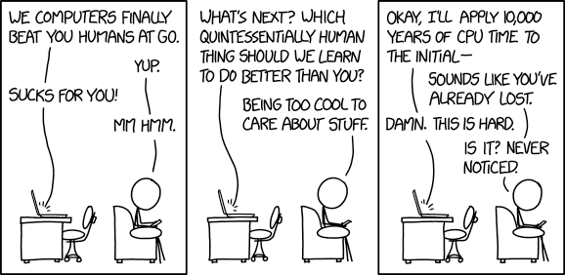
Outline
￼
Introduction
Fully-Connected Neural Networks
Convolutional Neural Networks
LSTM Neural Networks
GANs
https://www.explainxkcd.com/wiki/index.php/1875:_Computers_vs_Humans

Slide 3
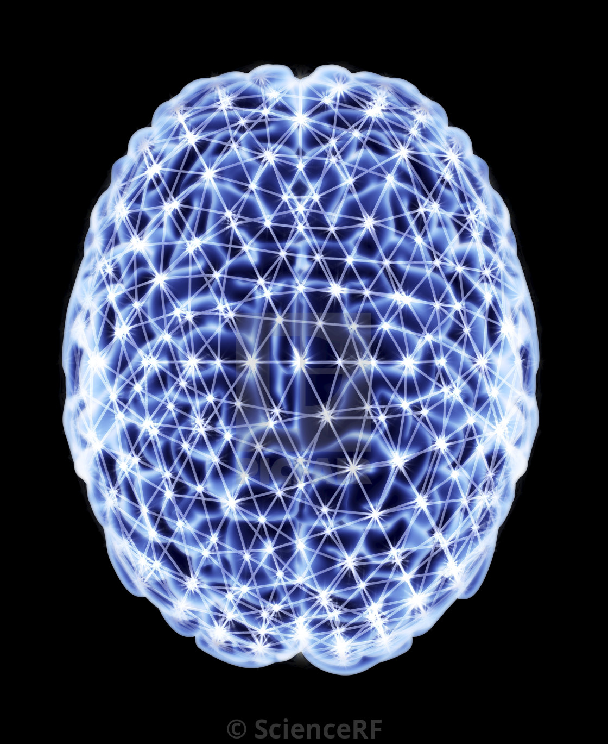
Fully-Connected Neural networks
They’re not that hard to understand (honestly)

Slide 4
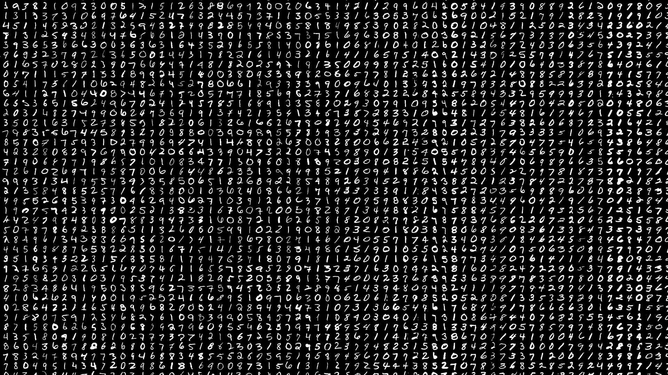
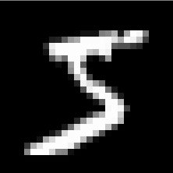
The MNIST dataset
LeCun et al. (1999)
Notes:
The benchmark and “hello world” for NNs
Dataset contains 60,000 train + 10,000 test handwritten numbers
Each number is a 28x28 pixel greyscale image

Slide 5
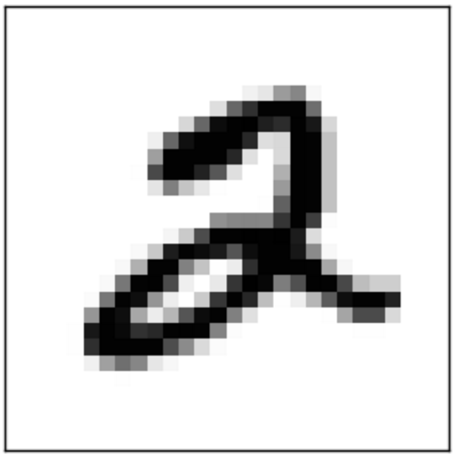
A single neuron
the specific values of the weights and bias are not determined until training is performed
input layer
Notes:
Flatten the input image (28x28 -> 784)
The neuron takes the input and converts it into a single number
A bias is added to do an overall shift up or down

Slide 6

Activation functions
Notes:
The output of the neuron is passed through a non-linear activation function
Unlike biological systems (rate of action potential firing in a cell) where the activation is a step here it is smooth (ish)
It is useful to rescale and limit the size of the output for the next layer
Different activations for different properties (trial and error)

Slide 7
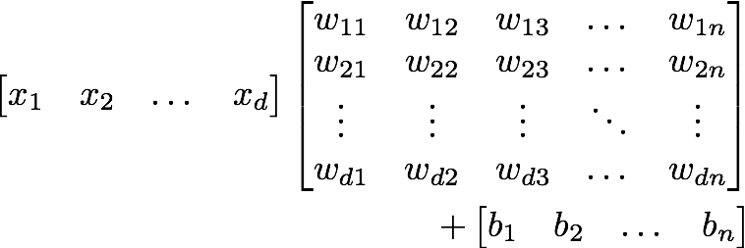
A simple network - A layer
Fully connected layer- all inputs to all neurons
Overall result is a big matrix operation
still processed through a non-linear activation function, e.g.,

Slide 8
A simple network - Multiple layers
multi-layer perceptron
input layer
hidden layers
output layer
classification
Notes:
1. Large number of parameters (perhaps 1000s, to millions)

Slide 9
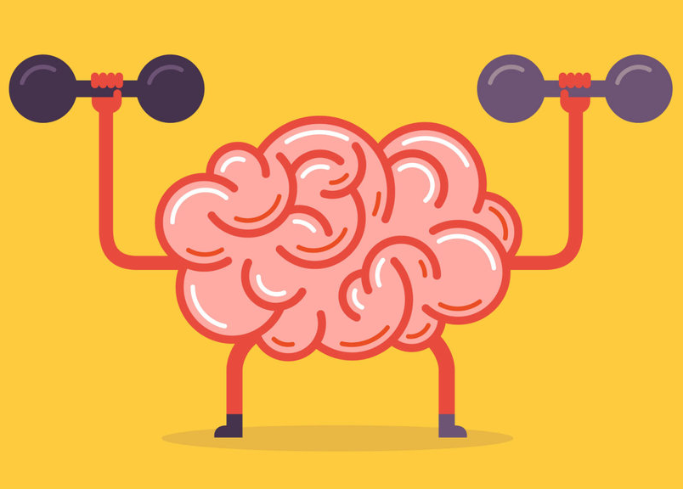
Training/Learning
A brain is useless without input
Notes:
1. Up to now we just have an empty brain

Slide 10
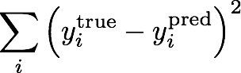
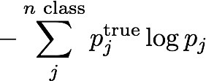
Loss functions
least squares
0.3
0
0.2
1
0.5
0
binary cross-entropy
Notes:
Want to define a measure of how well the network is doing for a given set of weights
Usually send in batches of images and compute the average loss for each batch
This is supervised learning - we know the answer for the training data

Slide 11
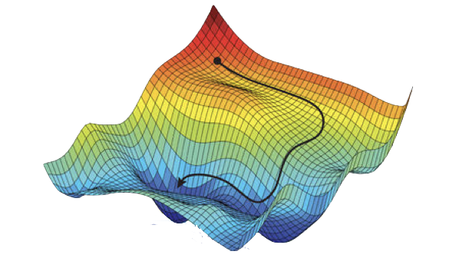
Gradient descent
Very large number of parameters
Compute local gradient and move “downhill” in proportion
Tricks to avoid local minima
Work in “batches” - stochastic gradient descent
Learning rate
Use momentum
in reality you can have millions of weights and biases
Machine “learning” here is simply minimising a loss function
Notes:
1. Mention learning rate

Slide 12
Back propagation
loss =
0.3
0
0.2
1
0.5
0
compute the nudges needed for each input summed over each output
propagate backwards
Notes:
An algorithm for computing the gradient
Not going into the maths - too many indices
Make sure everything is differentiable - use chain rule

Slide 13
Convolutional Neural Networks

Slide 14
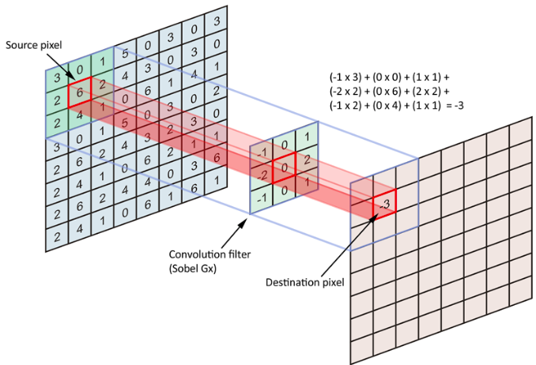
Convolutional Filter

Slide 15

Convolutional Stride

Slide 16
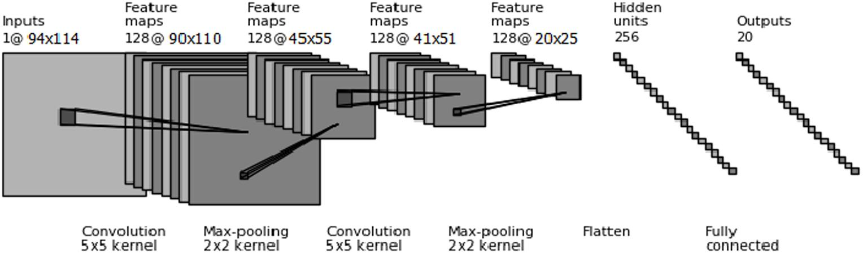
CNN Structure
5 | 2 | 4 | 6
3 | 9 | 7 | 1
7 | 5 | 4 | 4
8 | 7 | 1 | 8
14 | 9 | 5
8 | 13 | 11
14 | 6 | 12
1 | 0
0 | 1
Zevin et al CQG, 34, 6, 064003 (2017)
Notes:
input doesn’t have to be flattened - keep spatial structure
Less weights and biases

Slide 17
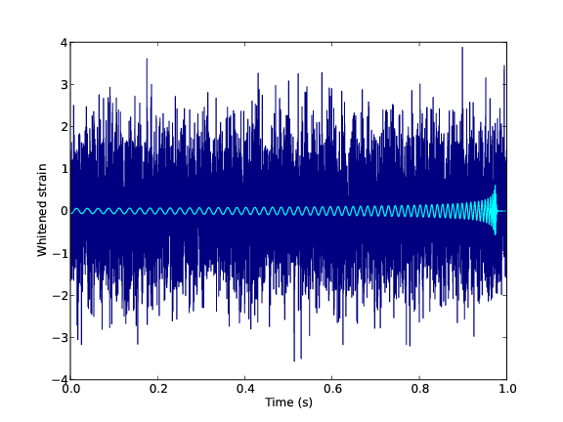
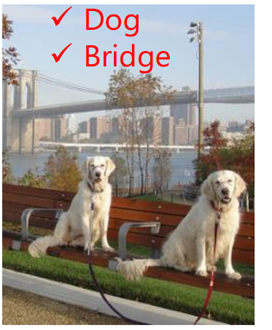
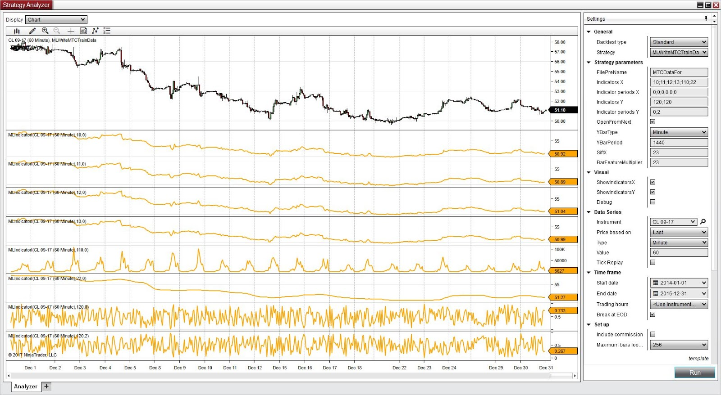
How are CNNs Useful?

Slide 18


LSTM Networks
Notes:
Photo credit: https://botnik.org/content/harry-potter.html

Slide 19
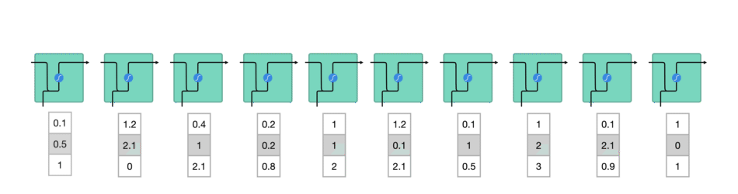
Recurrent Neural Networks
Notes:
Good at modeling sequence data.

Slide 20
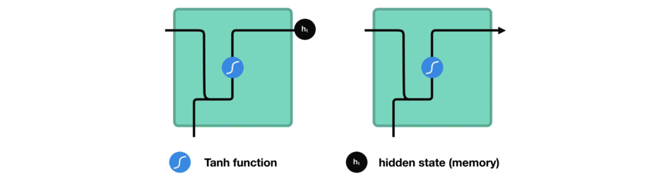
Recurrent Neural Networks
Notes:
Good at modeling sequence data.

Slide 21
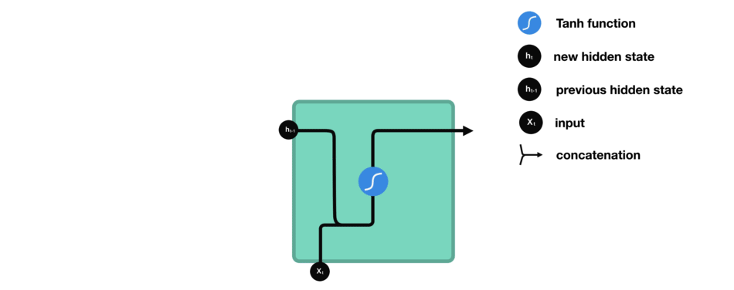
Recurrent Neural Networks
Notes:
Good at modeling sequence data.

Slide 22
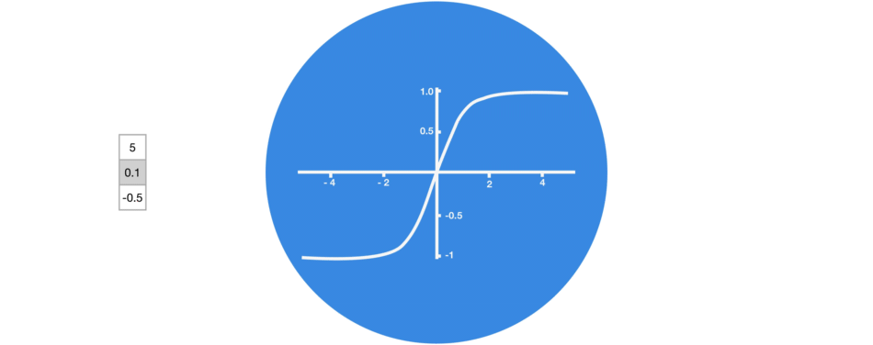
Tanh Activation Function
Notes:
Good at modeling sequence data.

Slide 23
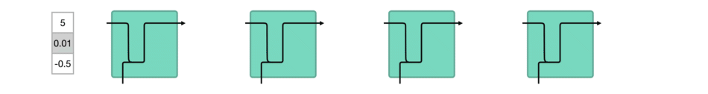
Tanh Activation Function
Notes:
Good at modeling sequence data.

Slide 24
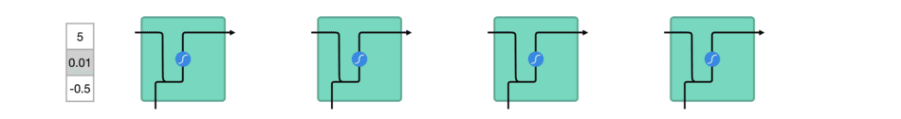
Tanh Activation Function
Notes:
Good at modeling sequence data.

Slide 25
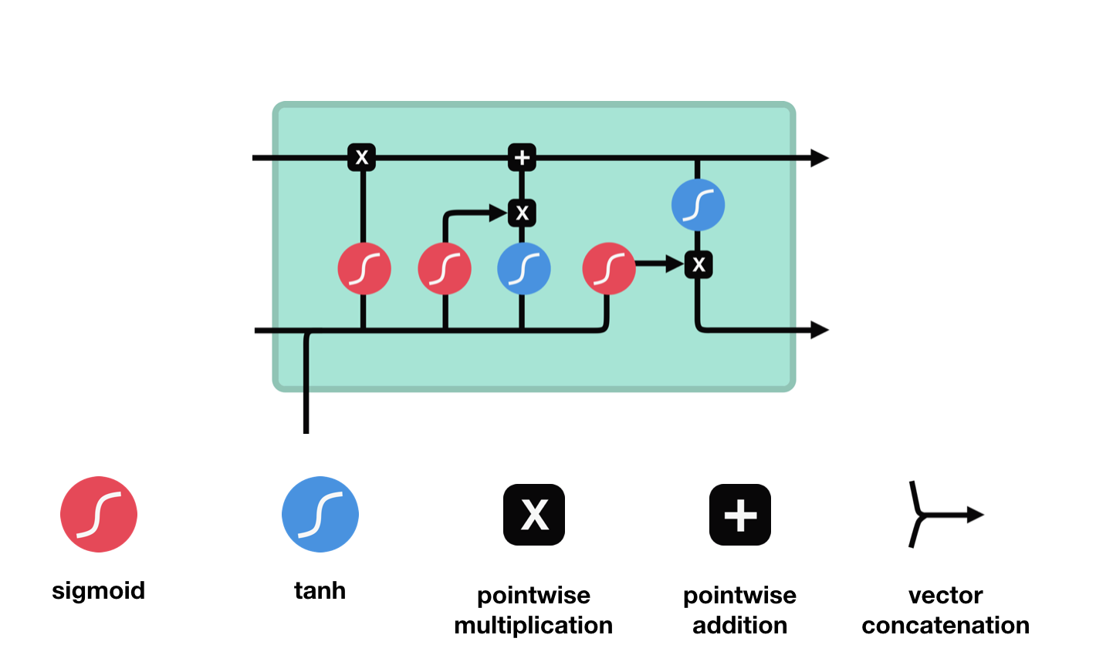
LSTM Networks

Slide 26
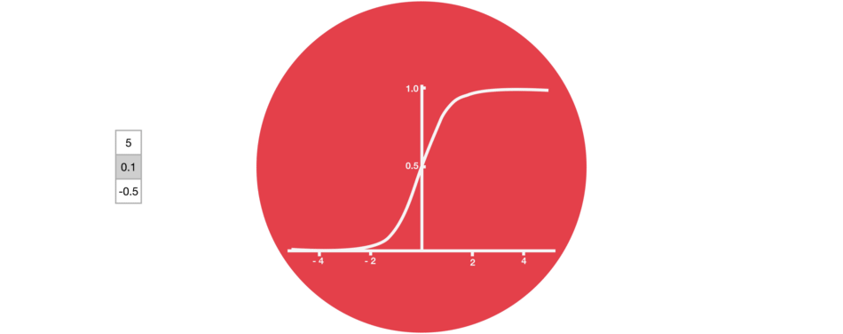
Sigmoid Activation Function

Slide 27
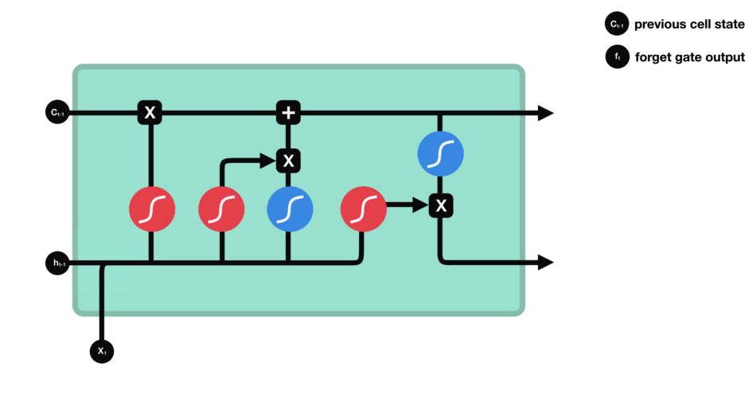
Forget Gate
Notes:
Information gets removed or added to the cell state via gates.
Info from previous hidden state and current input is passed through sigmoid.
Closer to zero means forget, while closer to one means keep.

Slide 28
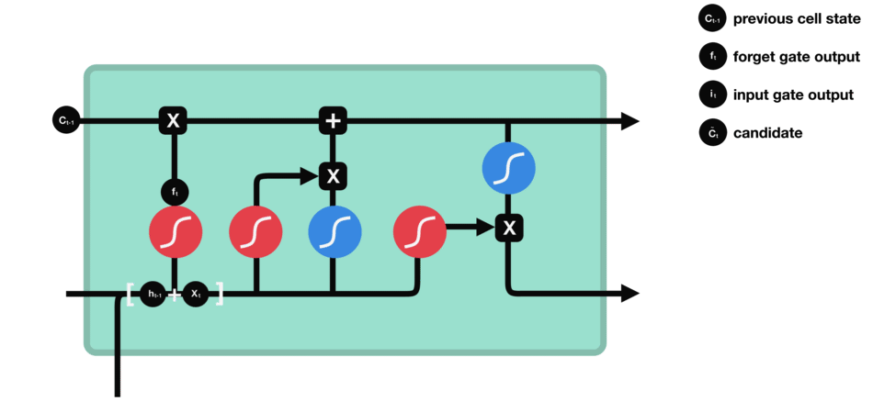
Input Gate
Notes:
Used to update the cell state
Again takes current state and previous hidden state as input through sigmoid.
Zero means not important, one means important.
Also take values and put them through tanh to regulate the network.

Slide 29
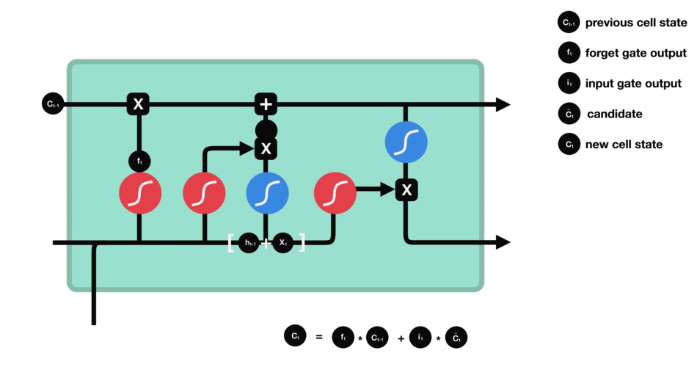
Cell State
Notes:
This is like the memory of the network.
Cell state gets multiplied by the forget vector.
Add input gate output, this updates cell state with new most important values.
We now have a new cell state.

Slide 30

Output Gate
Notes:
Decides what the next hidden state should be.
New cell state and new hidden state is then carried over to the next time step.

Slide 31
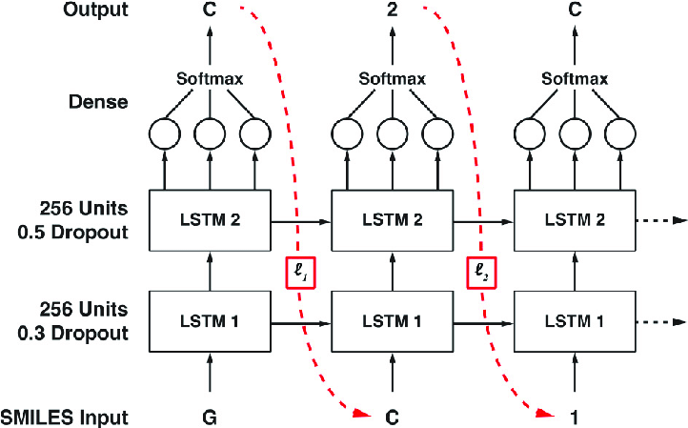
Deep LSTM Networks
Notes:
We can stack multiple cells in multiple layers to make a Deep LSTM.

Slide 32
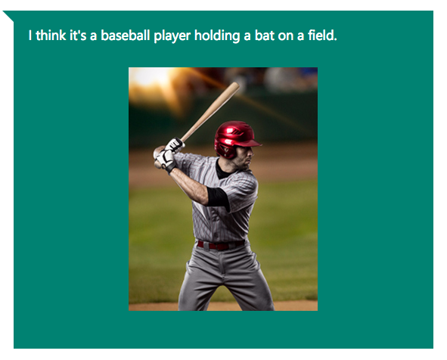

How are LSTMs used?
Speech synthesis
Text Generation
Add captions to videos
Music generation

Slide 33

Generative Adversarial Networks (GANs)
Getting better through competition

Slide 34
Why might GANs be useful?
In general they are very good at generating new data (hence “generative”)
They don’t need much training data
Useful for generating fake signals - paintings, text, etc.
Also useful for distinguishing real from fake

Slide 35
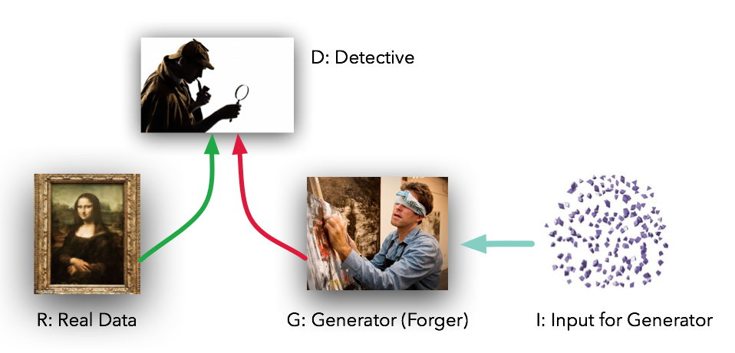
Fighting networks
doesn’t have to be random input
Notes:
1. Note that the input and output sizes are arbitrary - can go from small to big

Slide 36
Training Overview
The generator takes in random numbers and returns an image.
This generated image is fed into the discriminator alongside a stream of images taken from the actual dataset.
The discriminator takes in both real and fake images and returns probabilities, a number between 0 and 1, with 1 representing a prediction of authenticity and 0 representing fake.

Slide 37
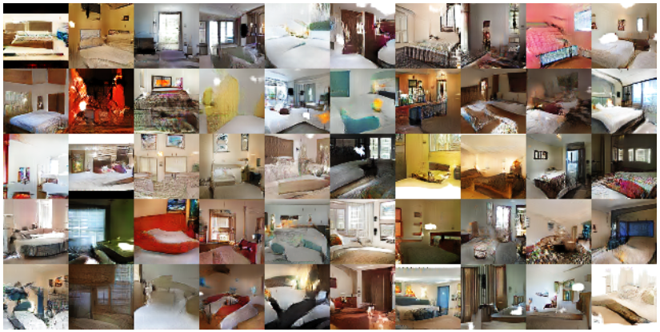
Interior design
Radford, Metz, Chintala, arXiv:1511.06434 (2015)

Slide 38
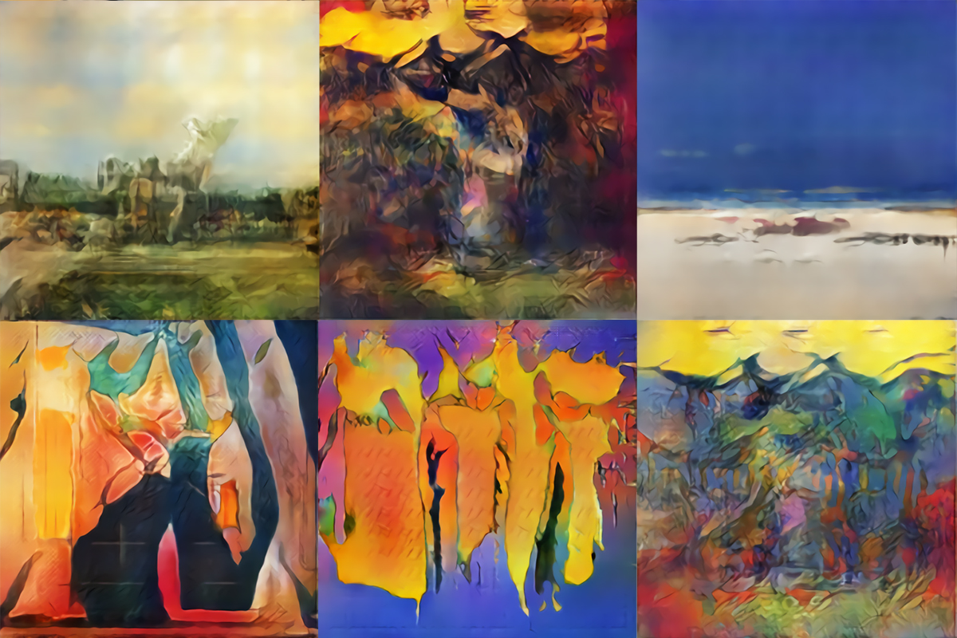
Painting

Slide 39
Practicalities - Actually getting started
Find a problem to solve (classification, parameter estimation, generation, …)
Find a simple network architecture that does better than chance
Build from there adding complexity in small increments and testing the performance
Simultaneously build up your training data size

Slide 40




Practicalities - General tips
Lots of software available (Keras, Tensorflow, Theano, PyTorch, …)
You are (kind of) wasting your time if you don’t have an Nvidia GPU
Be careful in generating your datasets
More training data usually means better performance

Slide 41
Practicalities - Training, validation and testing
Your entire dataset is usually divided into 3 groups
Training
Data used to train the network
Validation
Data used to check that the network isn’t over-fitting
Test
Data used to quantify the performance of the network
Notes:
1. Over-fitting is when the network learns how to solve the specific case of the training data but doesn’t transfer to other datasets

Slide 42
Practicalities - Bells and whistles
Max pooling
Dropout
Batch normalisation
Data augmentation
Transfer learning
and many more …

Slide 43

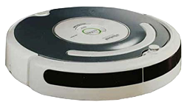
Now go take over the world
Follow instructions in reminder email I sent you on Saturday.

